Slide 1

CAPSTONE PROJECT #2 BANK CHURN DATA ANALYSIS
PRESENTED BY
NICHOLAS GIDDINGS
SNEHAL GAIKWAD

Slide 2
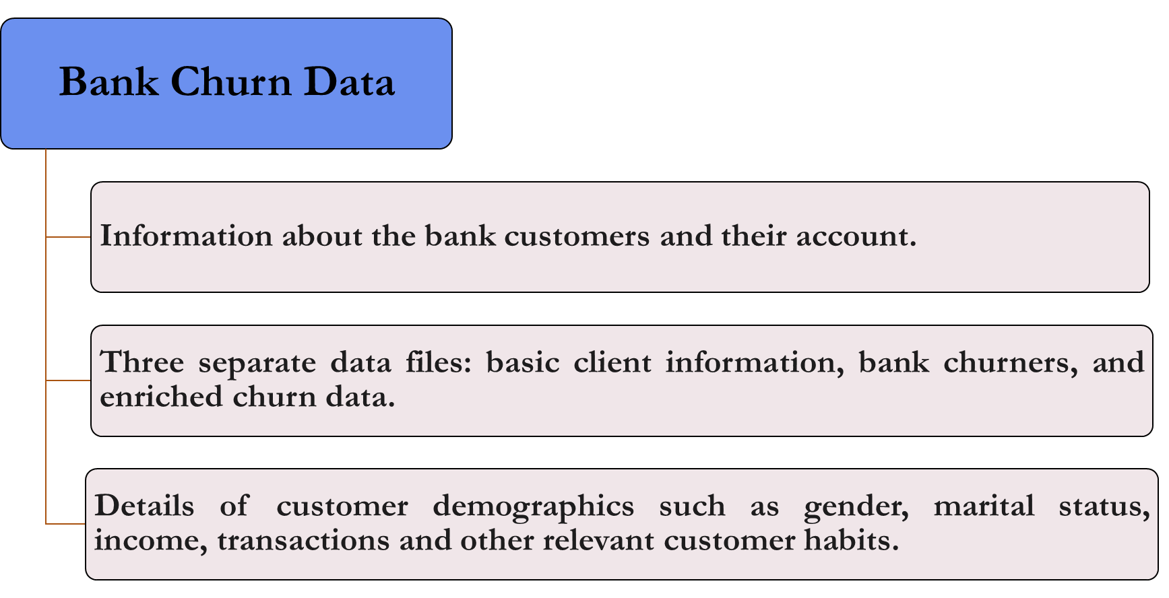

Slide 3
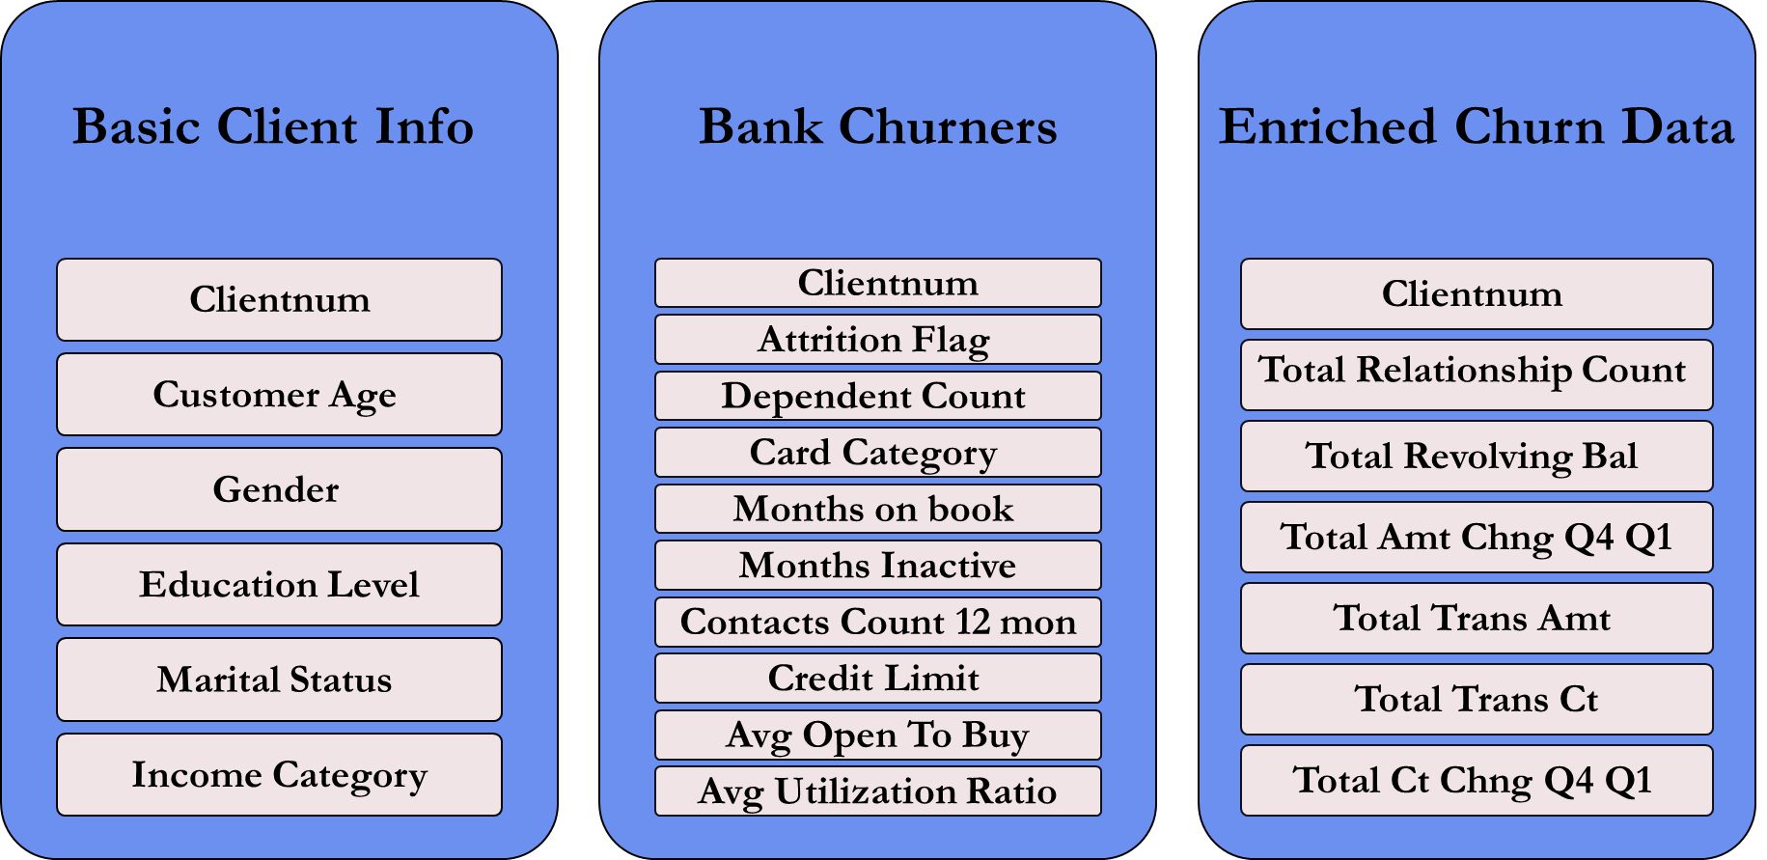
BANK CHURN DATA FILES

Slide 4
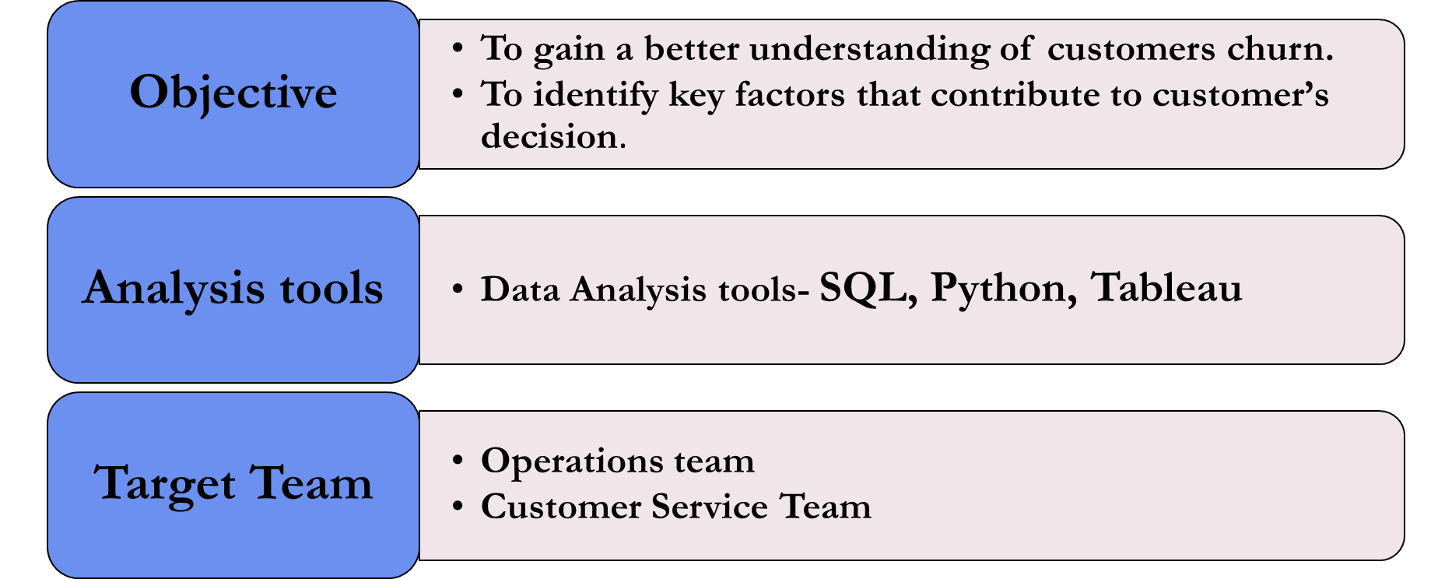

Slide 5
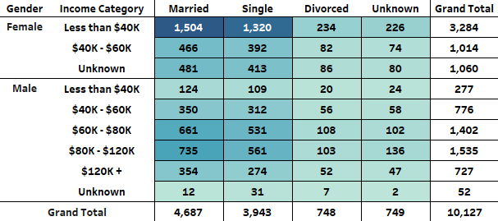
CUSTOMER DEMOGRAPHIC

Slide 6
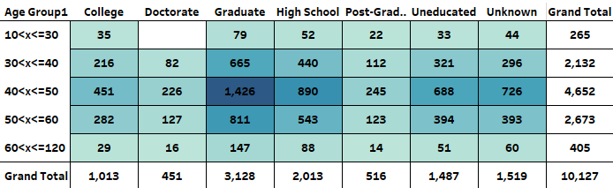
CUSTOMER AGE AND EDUCATION DETAILS

Slide 7
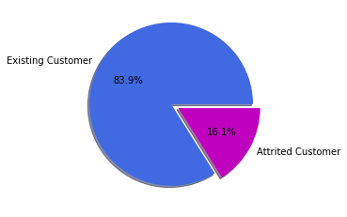

CHURNED CUSTOMERS

Slide 8
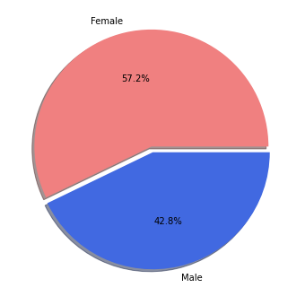

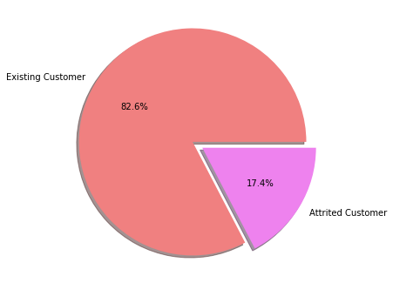
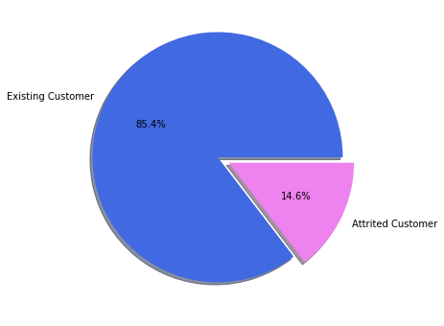
CHURN PERCENTAGE OF MALE AND FEMALE CUSTOMERS

Slide 9
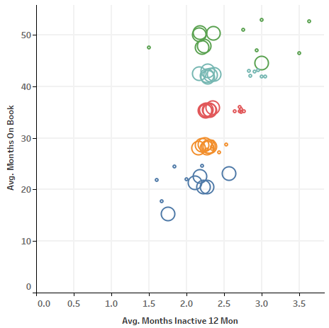
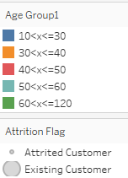
CUSTOMER CHURN AS PER AGE GROUP

Slide 10
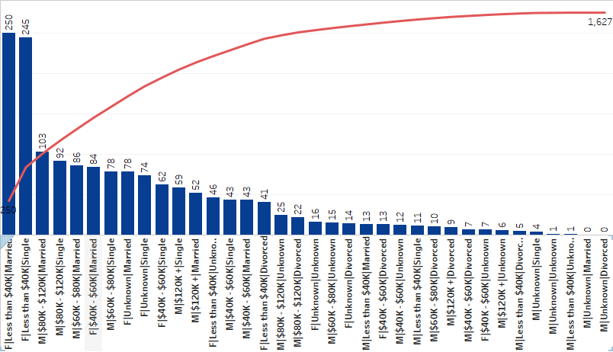
CHURN ANALYSIS FOR CUSTOMER SEGMENT (GENDER|INCOME|MARITAL STATUS)

Slide 11
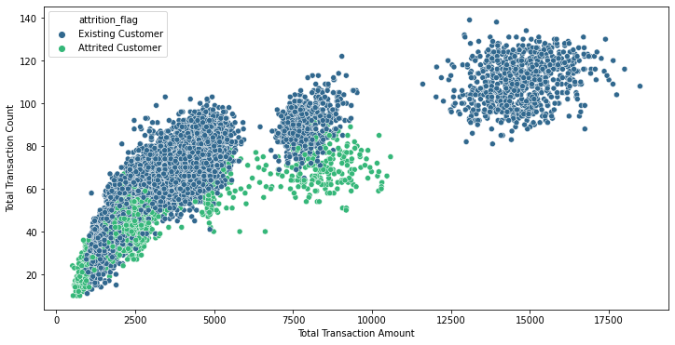
CUSTOMER’S TRANSACTION ANALYSIS

Slide 12
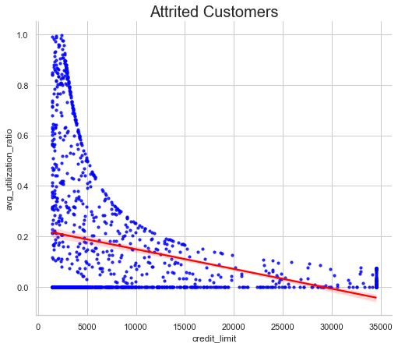
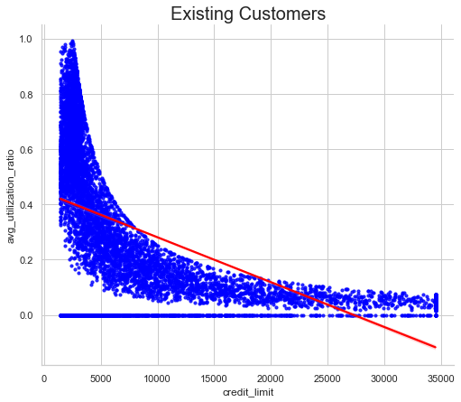
LINEAR MODEL PLOT OF AVERAGE CREDIT UTILIZATION RATIO AND CREDIT LIMIT

Slide 13
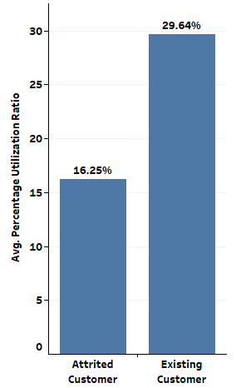
CUSTOMER’S AVERAGE UTILIZATION RATIO

Slide 14
CONCLUSION
In conclusion, our analysis of the customer data at the bank has provided us with valuable insights into the patterns and factors associated with customer churn.
With a churn rate of 16.1%, it is important for the bank to take action to minimize this trend. The higher rate among female customers and lower transaction amounts among churned customers suggest that gender and spending behavior may play a role in customer churn.
A lack of engagement and differences in credit limit policies between existing and churned customers were also noted as potential factors. Further analysis is necessary to confirm these observations and identify specific drivers of customer churn.
Notes:
‹#›

Slide 15
RECOMMENDATIONS
Conduct further investigation into the higher churn rate among female customers and identify the underlying causes.
Develop strategies to engage customers and prevent inactivity, which may play a role in customer churn.
Consider targeting the female customer segment in lower income categories to increase customer retention and minimize churn.
Investigate the relationship between total transaction amount and customer churn to establish a causal relationship and develop strategies to target customers who spend less.
Conduct further analysis of the relationship between credit limit and average utilization ratio to arrive at a conclusive interpretation and develop strategies to minimize customer churn.
Notes:
‹#›

Slide 16
Thank you

